Slide 1
Part 3c:
Understanding Inclusive Design
Marcelo Paiva (30min)

Slide 2
We need new tools

Slide 3
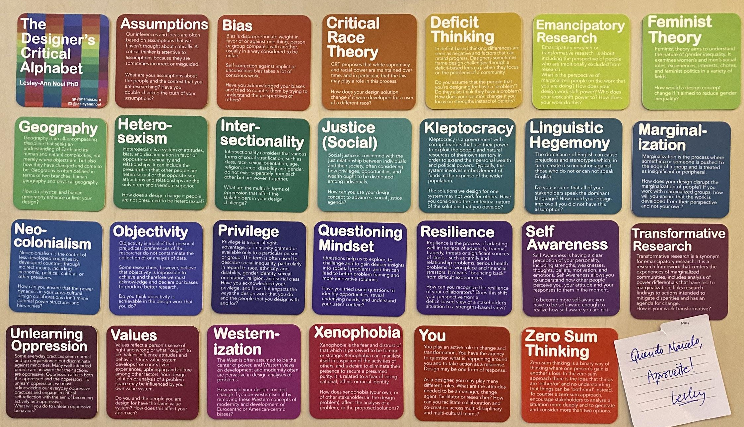
The Designer's Critical Alphabet
Lesley-Ann Noel PhD
ig: @lesleyannnoel / tw: @mamaazure
Ableism
Bias
Bias
Cultural
Disabilities
Bias
Bias is disproportionate weight in favor of or against one thing, person, or group compared with another, usually in a way considered to be unfair.
Self-correction against implicit or unconscious bias takes a lot of conscious work.
Have you acknowledged your biases and tried to counter them by trying to understand the perspective of others?
Ethnicity
Feminist Theory
Gender Equality
Heterosexism
Inequality
Justice (Social)
Kleptocracy
Linguistic
Hegemony
Marginalization
Neo- Colonialism
Privilege
Questioning Mindset
Religious
Sexual Orientation
Transgender
Identity
Unlearning Oppression
Values
Westernaliza-tion
Xenophobia
You
Zero Sum Thinking

Slide 4
The Designer's Critical Alphabet
Lesley-Ann Noel PhD
ig: @lesleyannnoel / tw: @mamaazure
Ableism
Ableism
Bias
Cultural
Disabilities
Ableism
Ableism is discrimination and social prejudice against people with disabilities or who are perceived to have disabilities. Ableism characterizes persons as defined by their disabilities and as inferior to the non-disabled.
Ableism is systematic, institutional devaluing of bodies and minds deemed deviant, abnormal, defective, subhuman, less than. Ableism is violence.
Does the Voice and Tone of your product promote an inclusive language?
Ethnicity
Feminist Theory
Gender Equality
Heterosexism
Inequality
Justice (Social)
Kleptocracy
Linguistic
Hegemony
Marginalization
Neo- Colonialism
Privilege
Questioning Mindset
Religious
Sexual Orientation
Transgender
Identity
Unlearning Oppression
Values
Westernaliza-tion
Xenophobia
You
Zero Sum Thinking

Slide 5
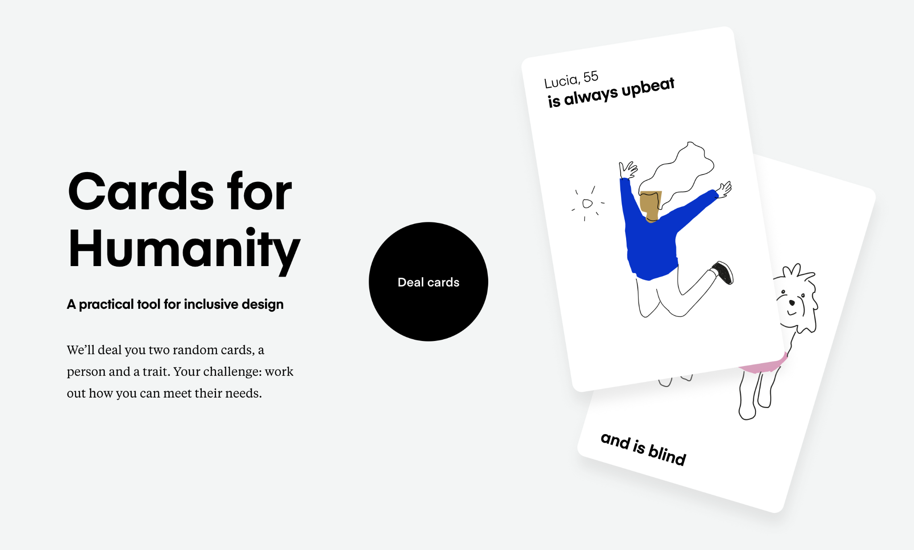

Slide 6
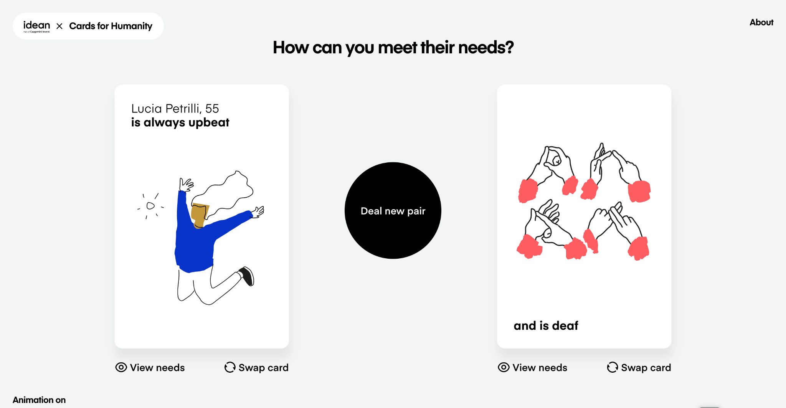

Slide 7
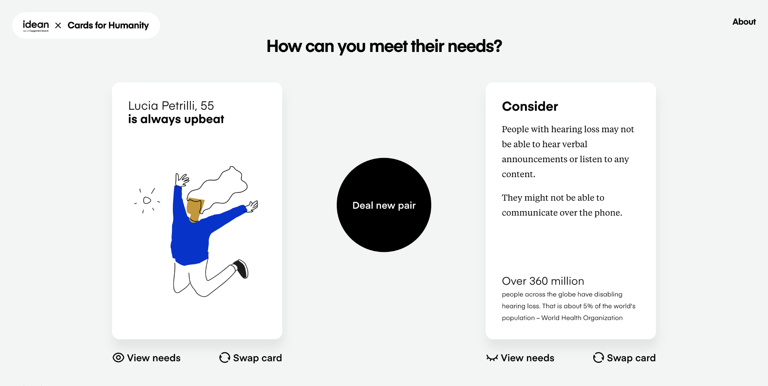

Slide 8
We need new methods

Slide 9
Accessible User Personas
People First: Designing for Differences

Slide 10


Chapter 2: People First: Designing for Differences
"You have to know the people you are designing for. And that includes people with disabilities."
Sarah Horton
Co-Author, A Web for Everyone: Designing Accessible Experiences

Slide 11
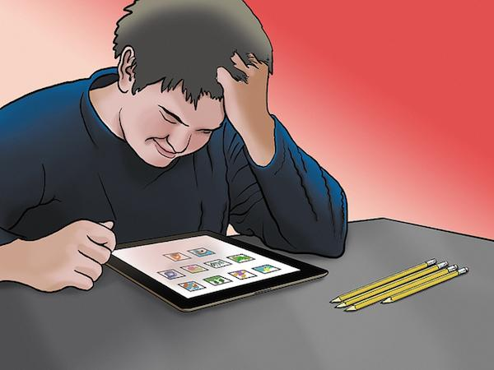
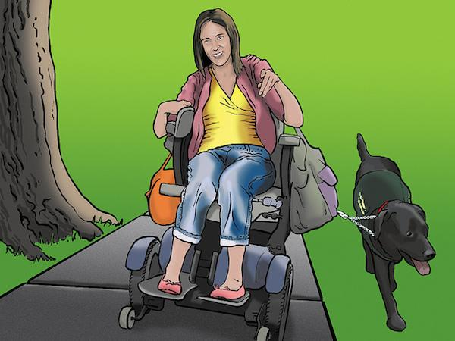

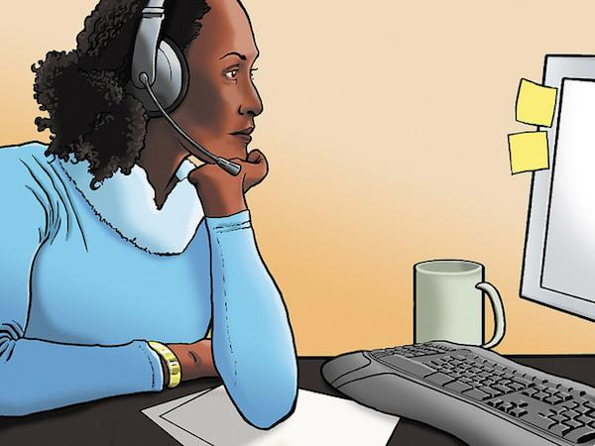
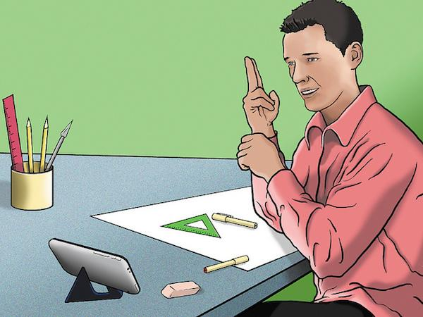
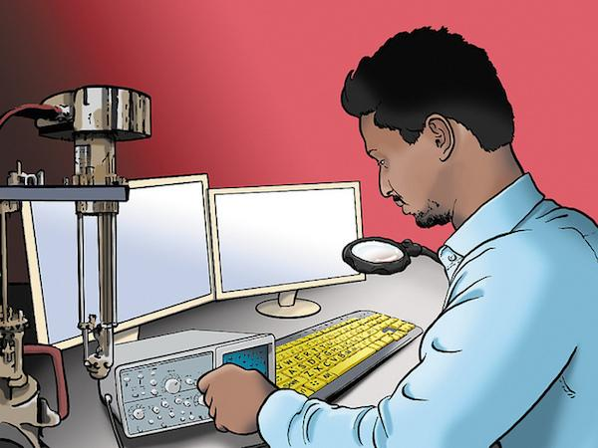
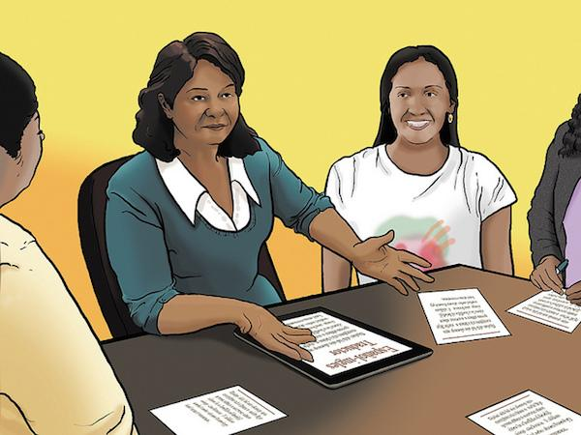

Chapter 2: People First: Designing for Differences
Trevor High school student with autism
Emily Cerebral palsy, living independently
Jacob Blind, a bit of a geek
Lea Living with fatigue and pain
Steven Deaf, ASL speaker
Vishnu Global citizen with low vision
Maria Bilingual mobile user
Carol Grandmother with macular degeneration
Illustrations by Tom Biby

Slide 12
We need new processes

Slide 13
Accessible User Stories
and Acceptance Criteria

Slide 14
Example
Keyboarding through Search Results
As a keyboard-only user, I want to keyboard navigate and filter the search results for jobs near me so that I can find work close to home.

Slide 15
Example
Acceptance Criteria
All functionality of the content is operable through a keyboard interface.
TAB key moves through the list of search results in the natural keyboard order of the intended interface layout.

Slide 16
Example
Acceptance Criteria
With focus on a filter heading, the SPACE or ENTER key will expand the filter accordion.

Slide 17
Example
Accessible Design Requirements
Focusable elements should be in a logical order and display a clear indication of focus.

Slide 18
Final Thoughts
How inclusive and diverse are your teams?

Slide 19
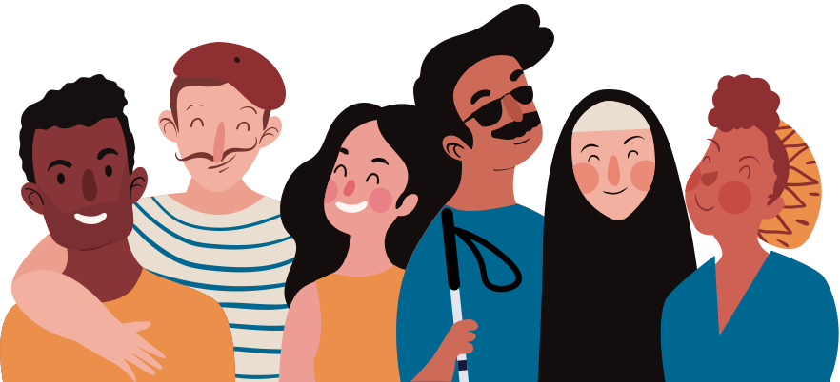
Inclusive Design
requires a diverse team composition
Illustration by freepik

Slide 20
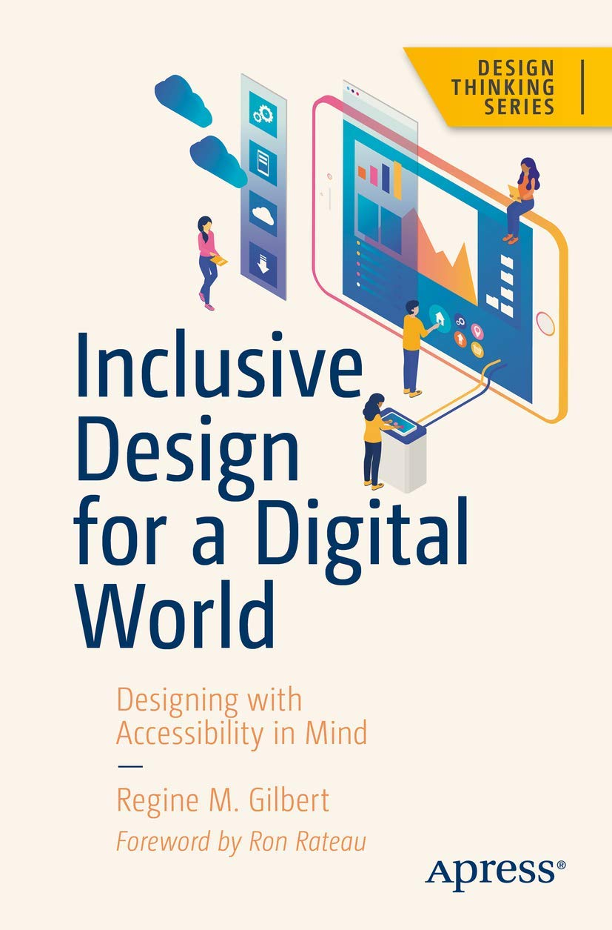

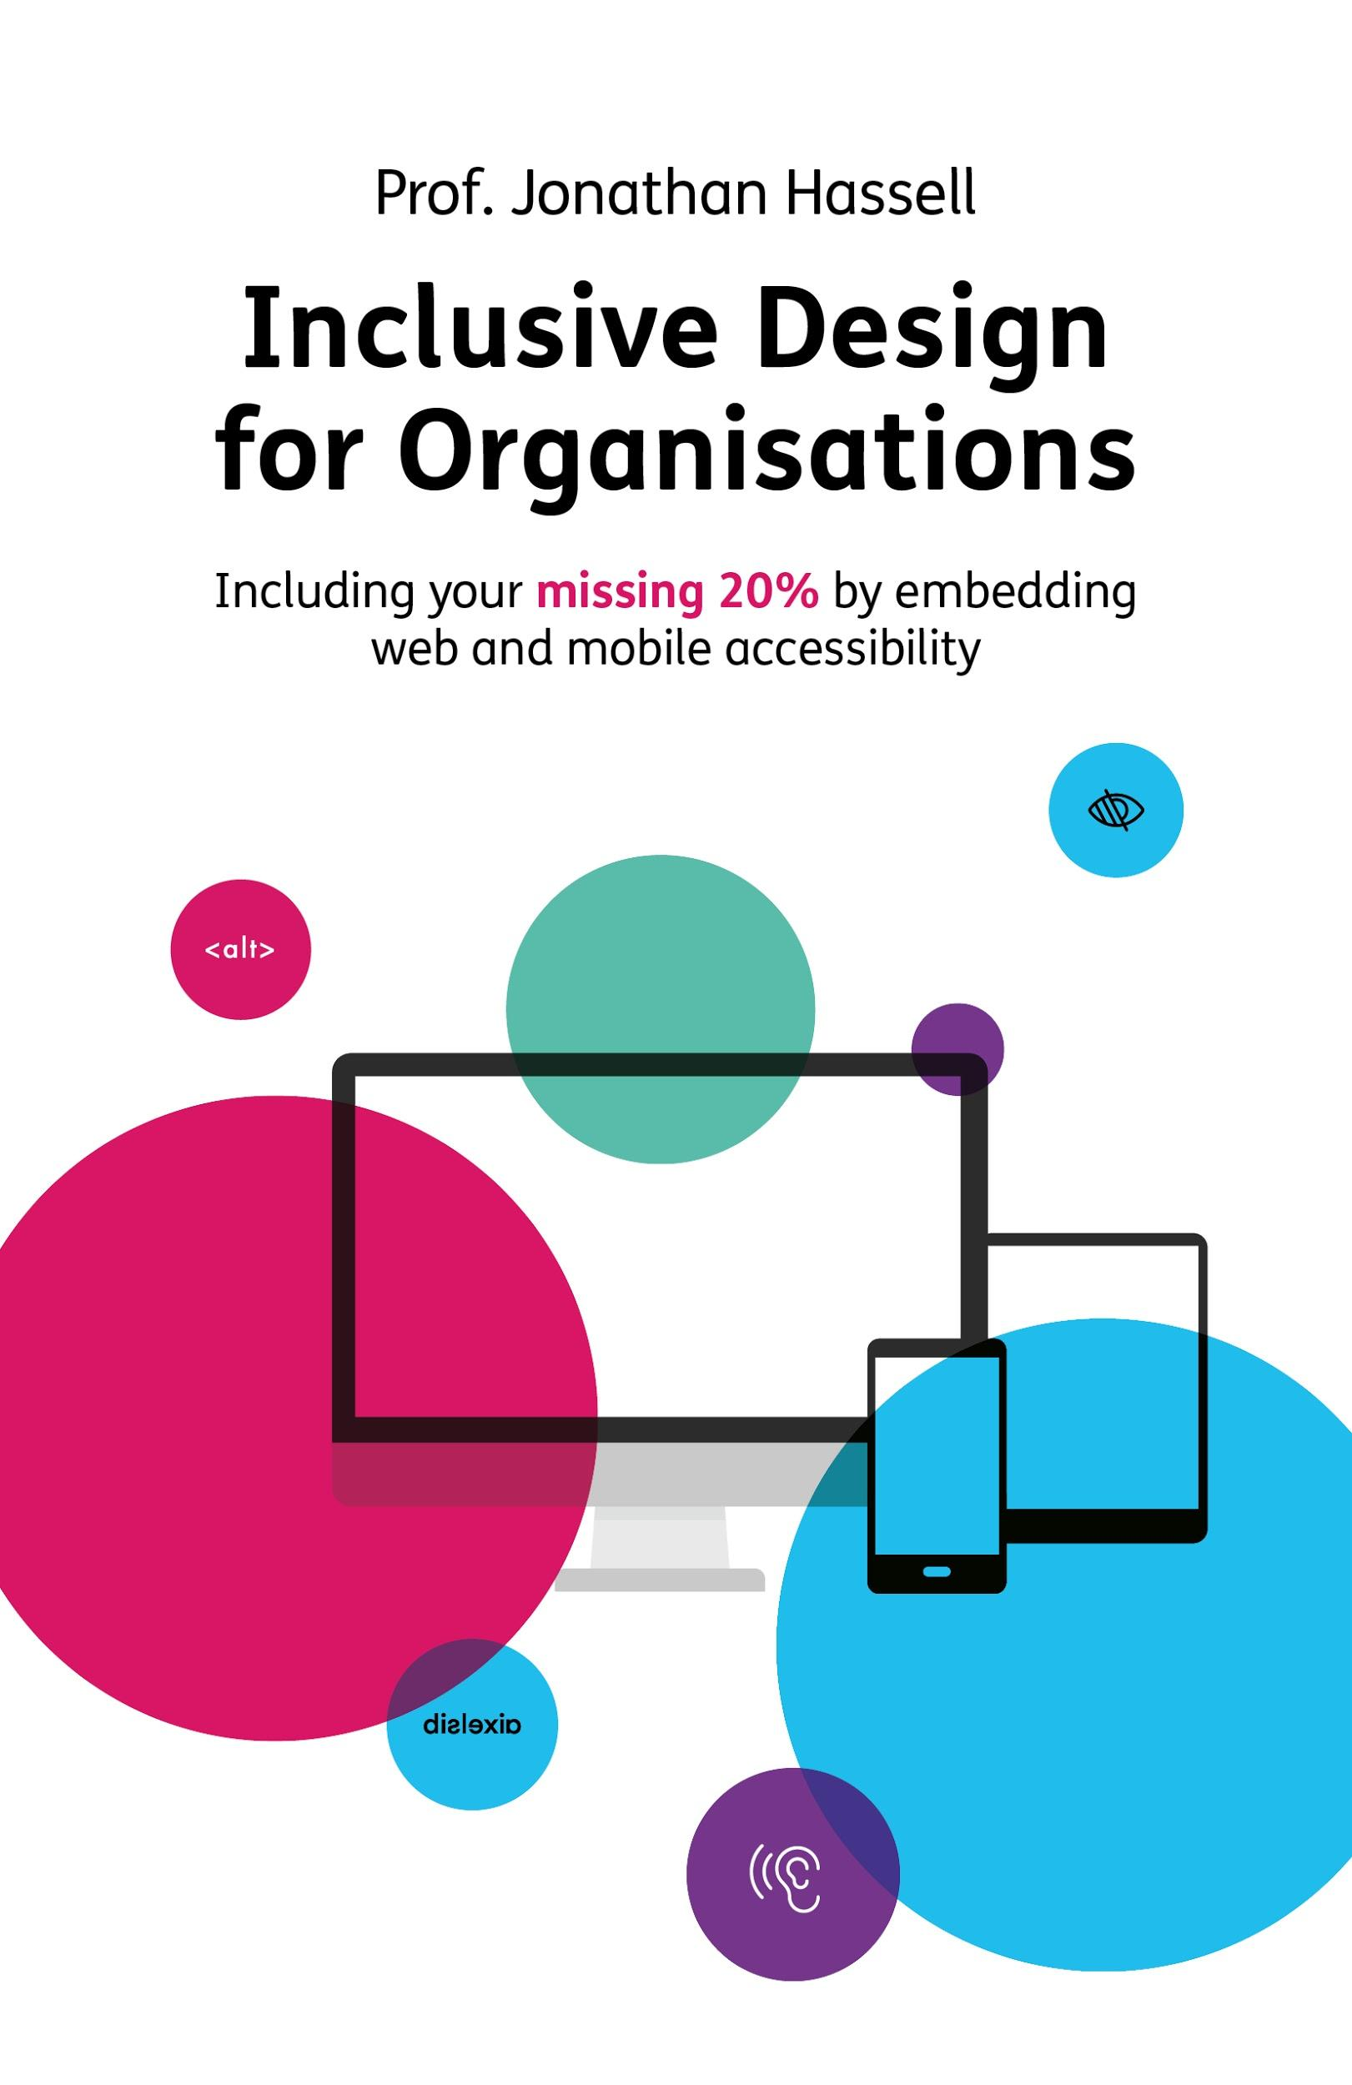
Recommended Reading
Inclusive Design for a Digital World
Regine M. Gilbert
Mismatch
How Inclusion Shapes Design
Kat Holmes
A Web for Everyone
Designing Accessible UX
Horton, Quesenbery
Inclusive Design for Organisations
Jonathan Hassell

Slide 21
Thank you!
Link to this presentation: bit.ly/vanguard-wk1

Slide 22
List of Resources
Downloads
Designing for your future self (Slides)
http://bit.ly/ixd21-futureself
Interview with your future self (Worksheet)
PDF: http://bit.ly/b2y-future-pdf
Figma: http://bit.ly/b2y-future-fig
Design Thinking 2.0 Playlist (Spotify)
https://open.spotify.com/playlist/3sslNp9ZvZ7jt0A0wZpuZx?si=OM0UdWfbS7mM79EoDiJK8w
Books
Inclusive Design for a Digital World
Regine M. Gilbert
Mismatch, How Inclusion Shapes Design
Kat Holmes
A Web for Everyone, Designing Accessible UX
Horton, Quesenbery
Inclusive Design for Organisations
Jonathan Hassell

Slide 23
List of Resources
References
The Designer's Critical Alphabet
Lesley-Ann Noel PhD instagram: @lesleyannnoel
http://criticalalphabet.com/
Words to Describe Different Disabilities
http://bit.ly/describing-disabilities
Fitbits and other wearables may not accurately track heart rates in people of color
https://www.statnews.com/2019/07/24/fitbit-accuracy-dark-skin/
What's your gender? I prefer not to say (CNN Health)
https://www.cnn.com/2021/02/02/health/gender-question-not-always-necessary-wellness/index.html
Companies Can’t Ignore Shifting Gender Norms (HBR)
https://hbr.org/2020/04/companies-cant-ignore-shifting-gender-norms
Microsoft inclusive Design Toolkit
https://www.microsoft.com/design/inclusive/
Supreme Court Declines to Review Ninth Circuit Decision in Robles v. Domino’s, Exposing Businesses to More Website Accessibility Lawsuits https://www.adatitleiii.com/2019/10/supreme-court-declines-to-review-ninth-circuit-decision-in-robles-v-dominos-exposing-businesses-to-more-website-accessibility-lawsuits/

